Slide 1
Musical Instrument Classification Using a Hybrid Neural Network
Landon Buell, Gradating Senior, Department of Physics and Astronomy
Kevin Short, Professor, Department of Mathematics and Statistics
University of New Hampshire, 8 Jan 2020

Slide 2
Introduction

Slide 3
Mapping Sounds to Sources
Humans are proficient at mapping sounds to sources
Impractical at a large scale
Computers are not proficient at mapping sounds to sources
Can handle large volumes of data

Slide 4
“Birds inspired us to fly, burdock plants inspired Velcro and nature has inspired many other inventions. It seems only logical then, to look to the brain’s architecture for inspiration on how to build an intelligent machine.”
- Aurelion Geron, Former YouTube Video Classification lead

Slide 5
The Neural Network

Slide 6
Structure
A neural network is a mathematical function
Composed of smaller functions called layers
Transform features into predictions

Slide 7
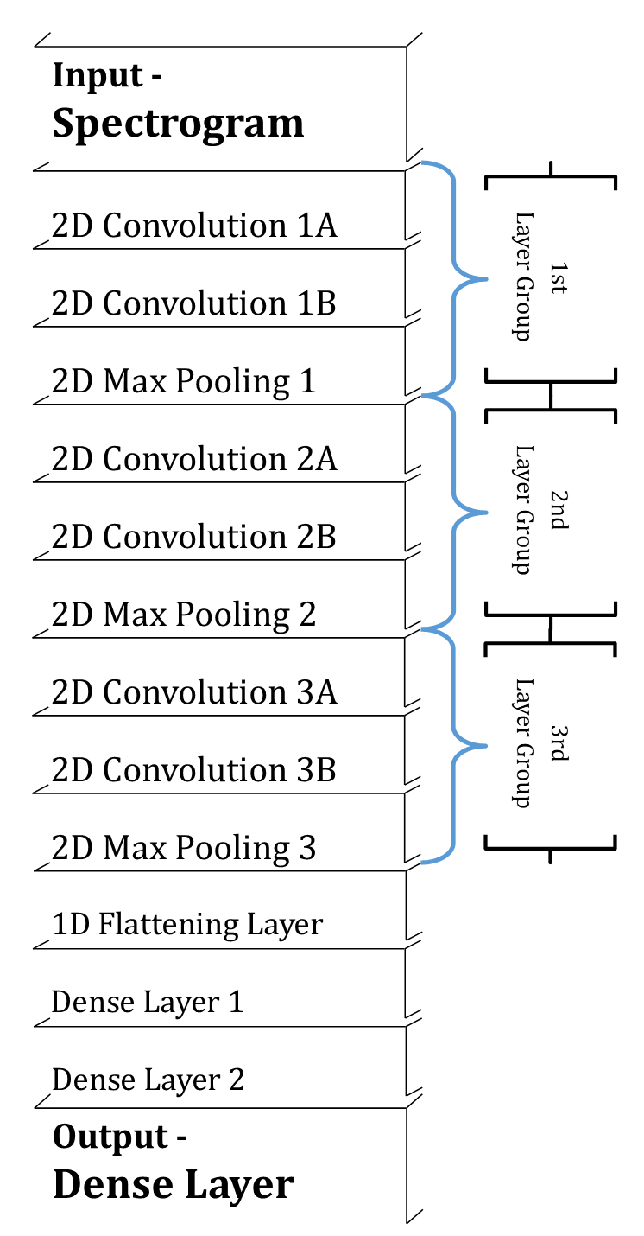
Convolutional Network
Input is 2D image-like array
Transformed through Convolution and Pooling layers.

Slide 8
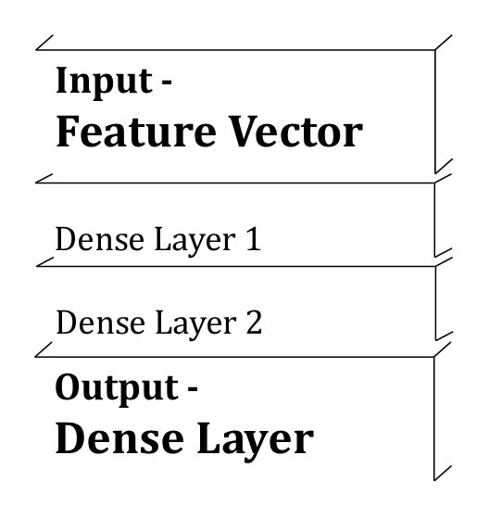
Multilayer Perceptron
Input is 1D array of features
Transformed through Dense layers.

Slide 9
Hybrid Network Architecture

Slide 10
Two Modes of Input
Each model uses a different input Modes
2D Spectrogram vs. 1D Feature Vector
Compare Modes to human senses

Slide 11
Hybrid Neural Network Architecture

Slide 12
Implementation
Define each arm by connecting layers as a linked-list structure

Slide 13
Performance of the Hybrid Model

Slide 14
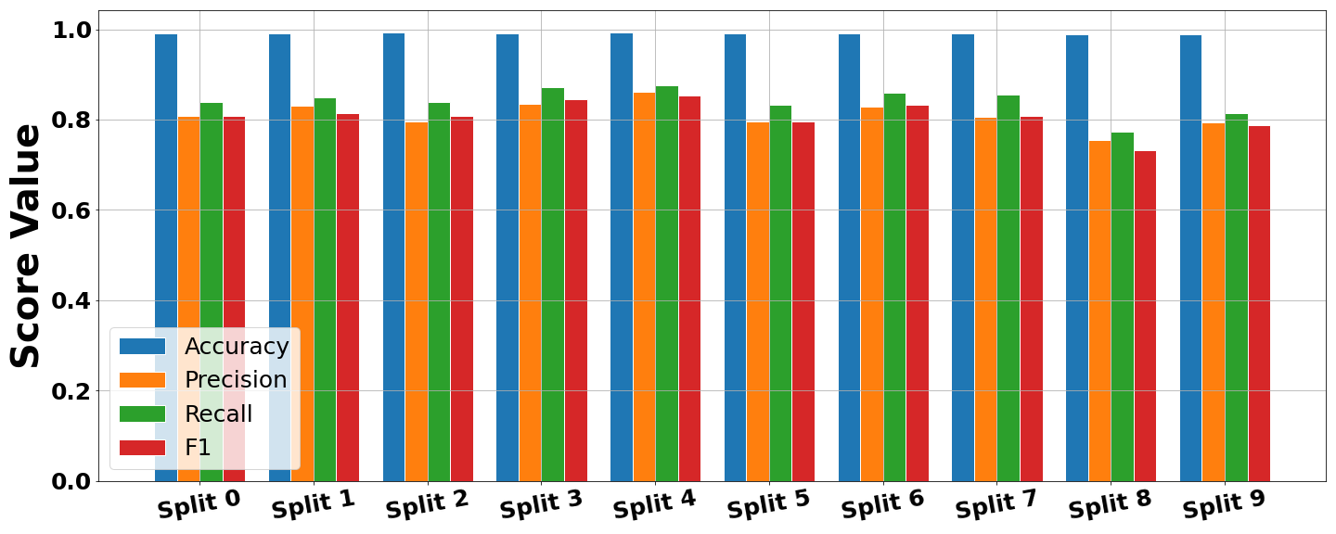
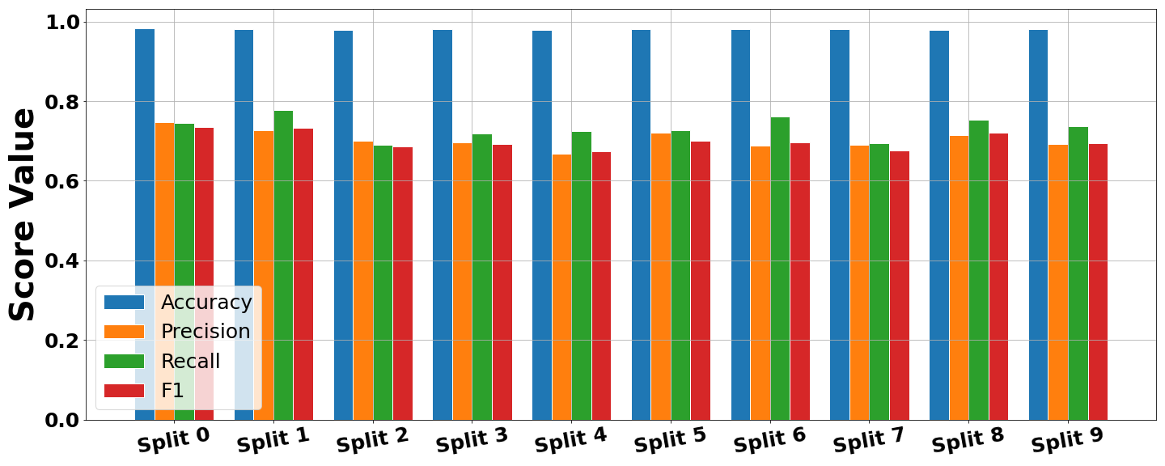
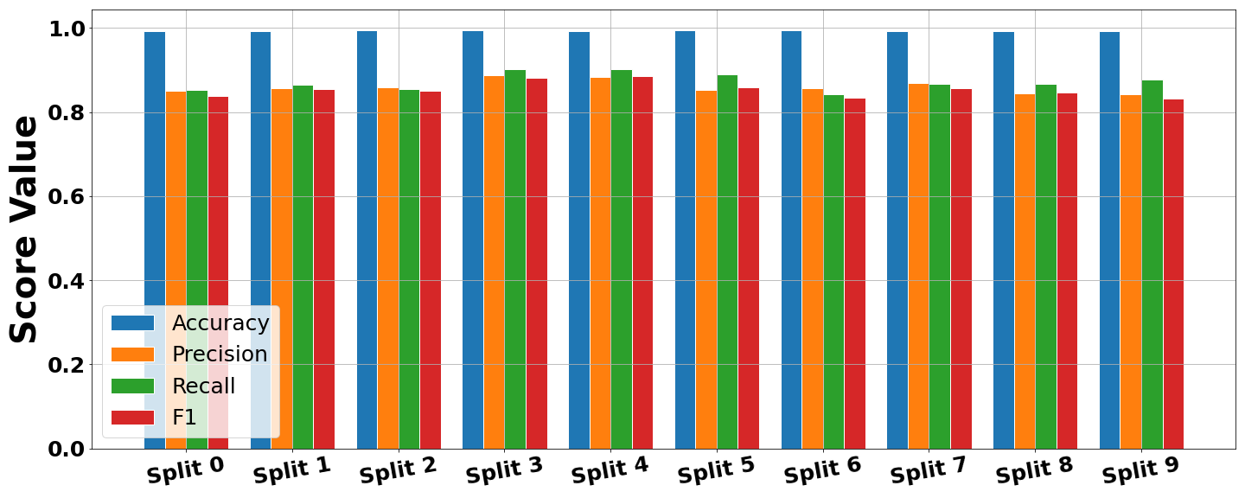
X-Validation Performance
1)
Three Separate Models’
CNN Architecture
MLP Architecture
Hybrid Architecture
Each unimodal achitecture learns a set of parameters
When combined, the
2)
3)

Slide 15
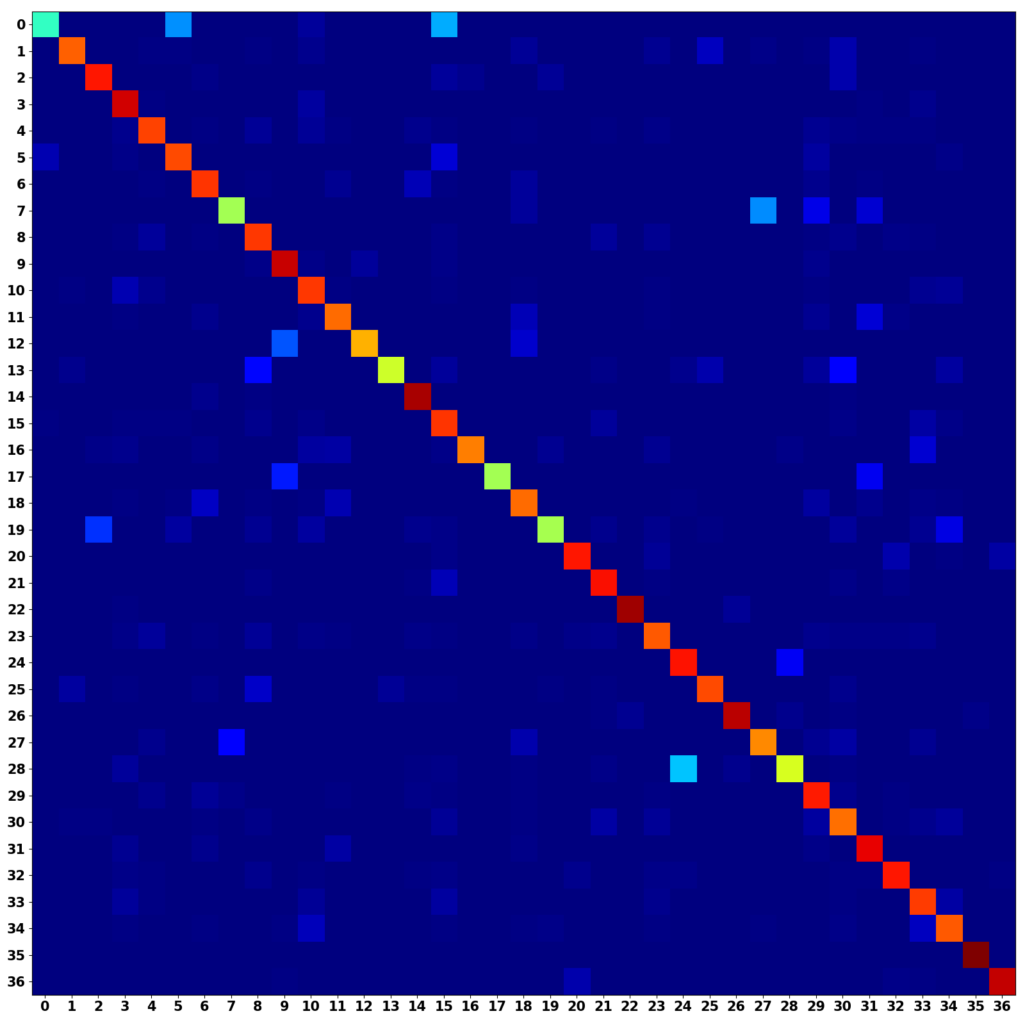
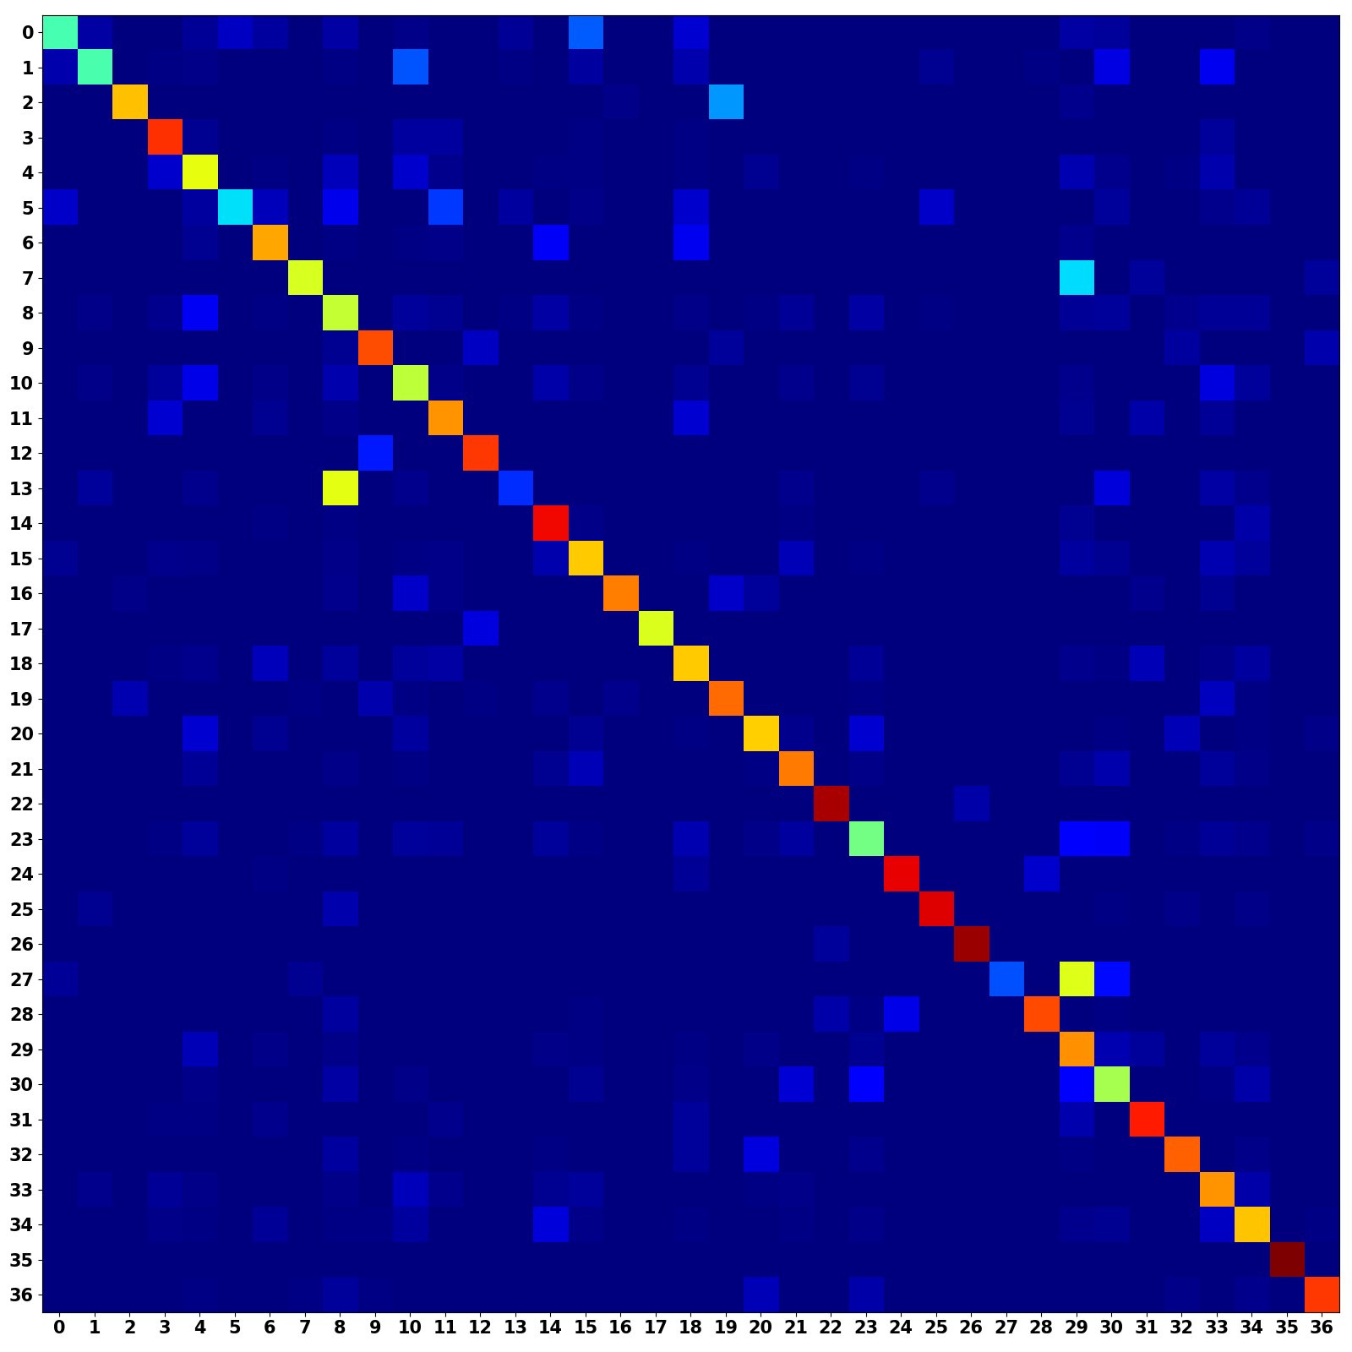
Unimodal Confusion Matrices
CNN Branch (Occurrence Weighted)
MLP Branch (Occurrence Weighted)

Slide 16
Multimodal Confusion Matrix
CNN + MLP (Occurrence Weighted)
Multimodal models shows a stronger main diagonal
Combines predictive power from both architectures

Slide 17
Discussions and Conclusions
Hybrid architecture allows for single sample to be effectively convey with two different input modes
The Multimodal Model Improves musical instrument classification performance
We would like to deploy this model to classify unlabeled chaotic synthesizer waveforms

Slide 18
Citations
[1] Geron, Aurelien. Hands-on Machine Learning with Scikit-Learn and TensorFlow: Concepts, Tools, and Techniques to Build Intelligent Systems. O’Reilly, 2017.
[2] Goodfellow, Ian, et al.Deep Learning. MIT Press, 2017.
[3] Khan, M. Kashif Saeed, and Wasfi G. Al-Khatib. “Machine-Learning Based Classification of Speech and Music.” Multimedia Systems, vol. 12, no. 1, 2006, pp. 55–67., doi:10.1007/s00530-006-0034-0.
[4] Li, Yingming, and Ming Yang. “A Survey of Multi-View Representation Learning.” Journal of LateX Class Files, vol. 14, no. 8, Aug. 2015.
[5] Liu, Zhu, et al. ”Audio Feature Extraction and Analysis for Scene Segmentation and Classification.” Journal of VLSI Signal Processing, vol. 20, 1998, pp. 61–79.
[6] Ngiam, Jiquan, et al. ”Multimodal Deep Learning.” 2011.
[7] TensorFlow: Large-scale machine learning on heterogeneous systems, 2015. Software available from tensorflow.org.
[8] Virtanen, Tuomas, et al. Computational Analysis of Sound Scenes and Events. Springer, 2018.
[9] White, Harvey Elliott, and Donald H. White. Physics and Music: the Science of Musical Sound. Dover Publications, Inc., 2019.

Slide 19
Questions?
Additional information + Formal Write-up is available
Landon Buell – lhb1007@wildcats.unh.edu
Kevin Short – kevin.short@unh.edu
Project GitHub Repository:
https://github.com/landonbuell/Buell-Senior-Thesis

